Slide 1

Predicting Consumer Tastes with Big Data at Gap

Slide 2
Web Data Analytics Group 10
Chinmay Gidwani
Yukti Sanjay Jain
Anton De Franco
Samarth Bansal
Notes:
Samarth

Slide 3
Gap Inc History
Background: Art Peck took over as CEO of Gap Inc. in February 2015, following a period of declining sales in the retail industry. He had previously served as President of Growth, Innovation, and Digital, where he implemented Gap's digital strategy.
Troubled History: Gap Inc. had been struggling to recover since 2000, and Peck was faced with the challenge of revitalizing the brand.
Eliminating Creative Directors: One of Peck's strategies for improving operations was to eliminate the position of creative director for each of Gap's fashion brands. These creative directors played a significant role in shaping the image and design direction of the brand. Peck believed that concentrating too much power in one individual was not effective.
Notes:
Samarth

Slide 4

Business Problem
Gap failed to keep up with the observed changing customers’ behaviors in the clothing market.
As a result, competitors such as Zara and H&M could easily gain a considerable share of the apparel market in the United States by offering fast fashion items at low prices compared to the case of Gap.
Peck faced the challenge of heavy and frequent discounting as consumers perceived the products to be of low-quality fashion which was disposable.
Notes:
Samarth

Slide 5







Analysis Methodology
Percent change In stock price over time
Google Trends
Sentiment Analysis
Difference in Coefficients
10-K Data
Notes:
Samarth

Slide 6
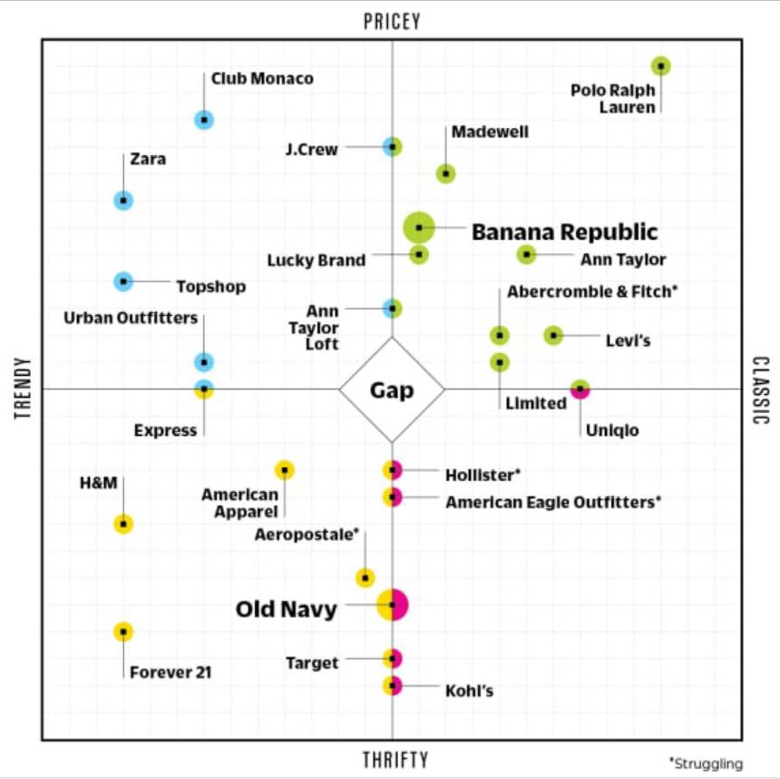
Competitor Analysis
American Eagle is a chain selling trendy casualwear, shoes, accessories & loungewear for guys & girls.
It makes more than 85% of its sales from the region.
American Eagle looks better poised for future gains as it has two of the fastest-growing brands (Aerie and American Eagle) in the apparel market.
Finally, American Eagle has a robust digital network. The company’s digital channel continued to flourish as digital demand surged by 48% in Fiscal year 2018.
American Eagle even keeping its creative directors has been doing well in respect with sales and revenue when compared to Gap.
Notes:
Samarth

Slide 7
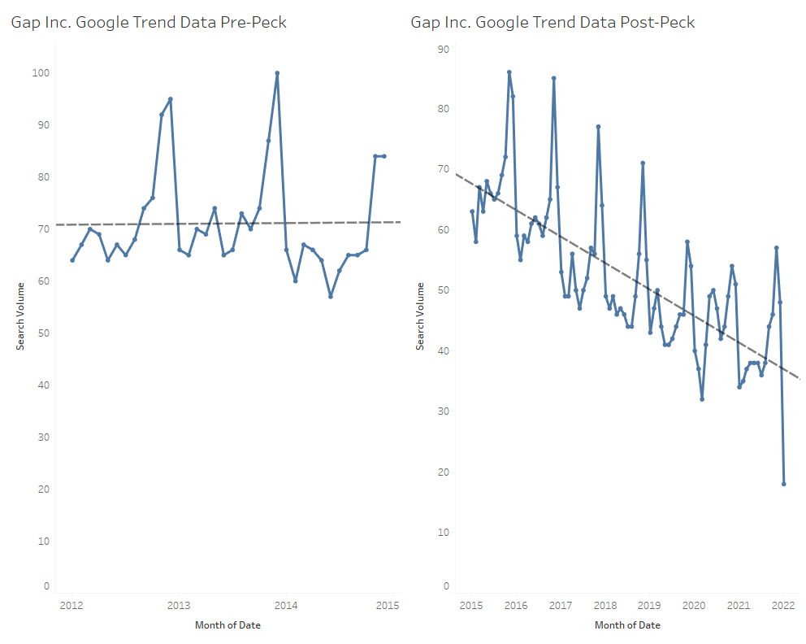
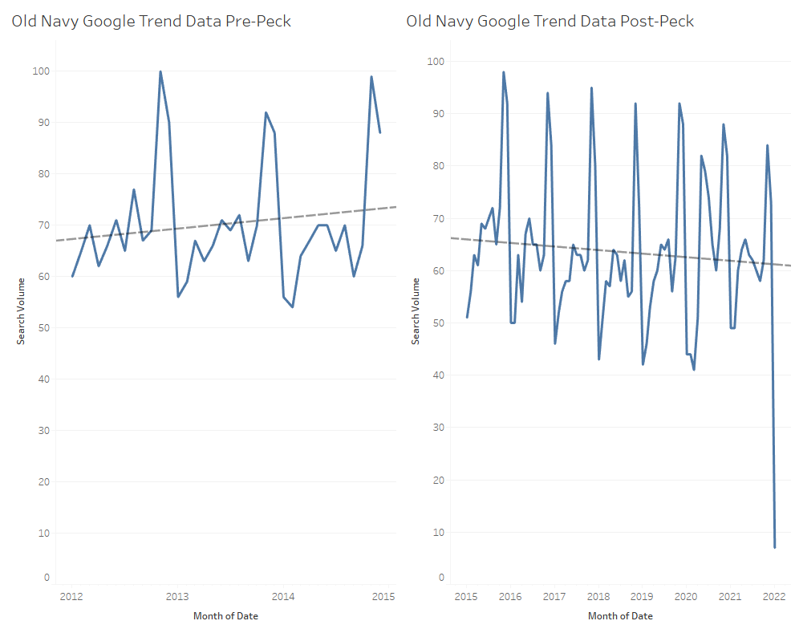
Pre-2015 and Post-2015 Google Trends Data
P-Value: 0.93
P-Value: 0.001
P-Value: 0.37
P-Value: 0.37
Notes:
Samarth

Slide 8
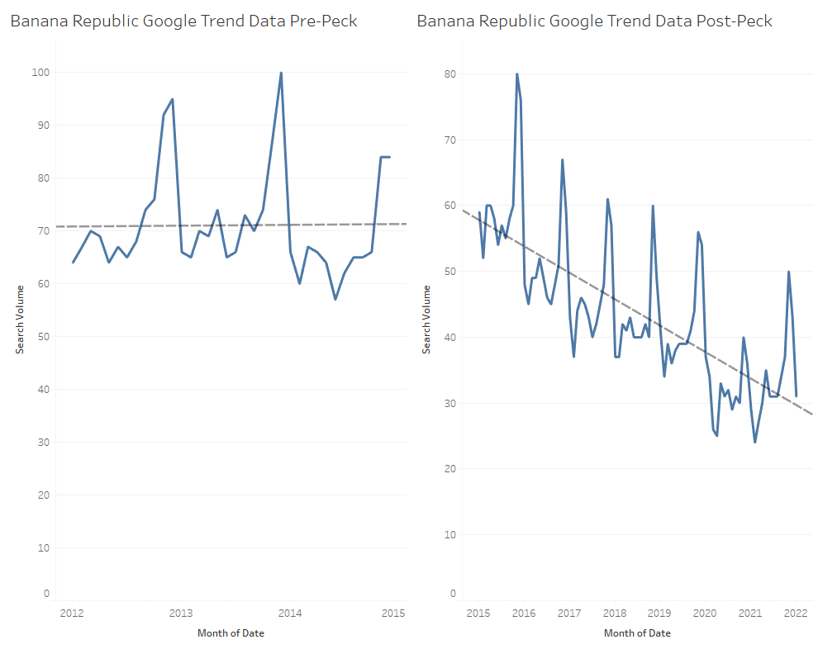
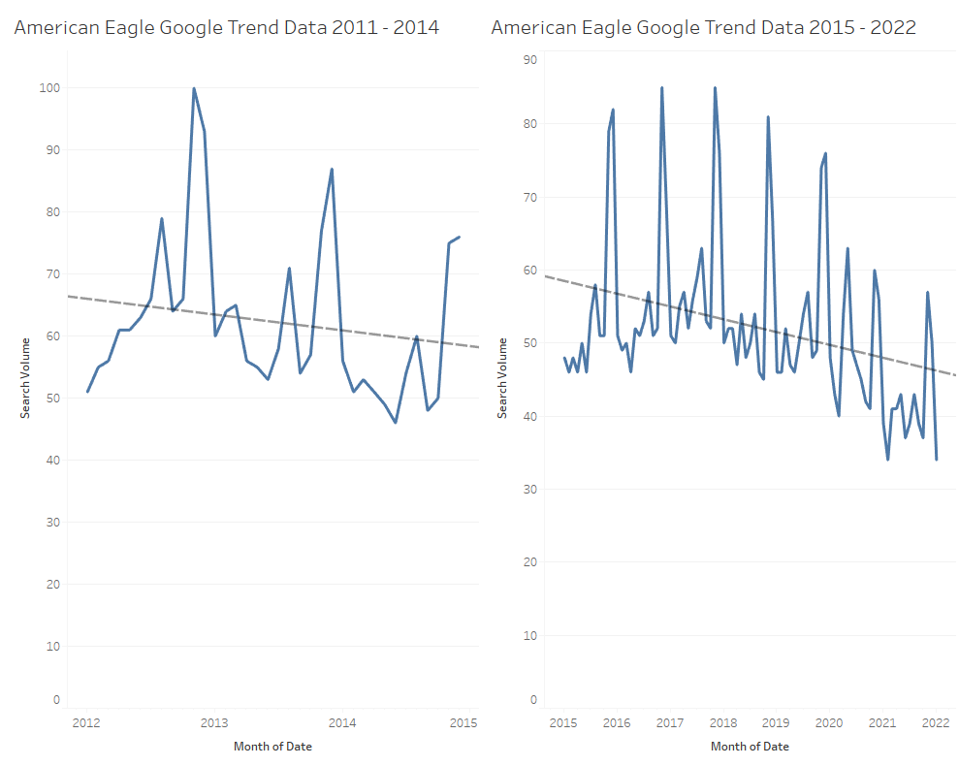
Pre-2015 and Post-2015 Google Trends Data
P-Value: 0.93
P-Value: 0.001
P-Value: 0.30
P-Value: 0.002

Slide 9
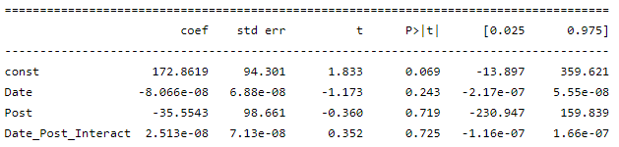
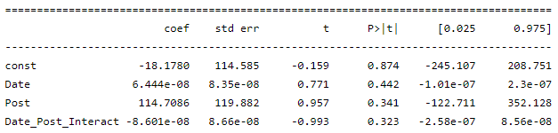
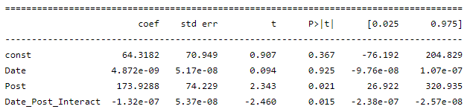
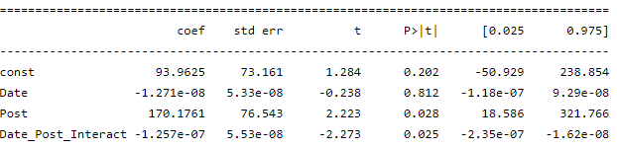
Differences in Coefficients from Trend Data
American Eagle:
Old Navy:
Banana Republic:
Gap:
Notes:
Samarth

Slide 10
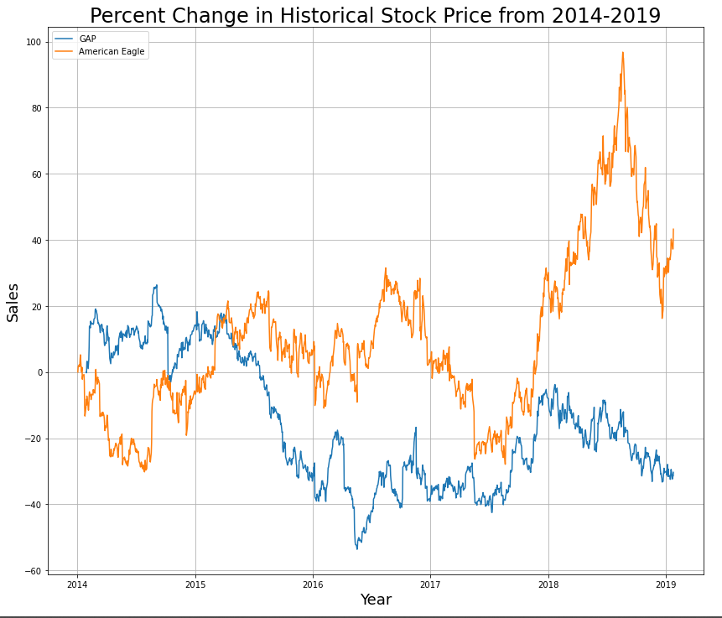
Percent Change in Stock Price Over Time
Notes:
Samarth

Slide 11
10-K Data
We collected financial data from The Gap's 10-K filings spanning from 2012 to 2019.
The data encompassed key financial indicators, notably the net sales of The Gap's individual brands, including Old Navy, Banana Republic, and Gap itself.
Additionally, we acquired 10-K data from American Eagle Outfitters, a chosen competitor of The Gap due to its similarity in market segment, market capitalization, and target audience.
The financial metrics examined included net sales, gross margin, merchandise inventory, and operating margin.
We utilized this data to create line charts illustrating the trends in the selected financial metrics.
The objective was to analyze and visualize how these metrics evolved both before and after a change in leadership, specifically when a new CEO, Peck, took over at The Gap.
Notes:
Samarth

Slide 12
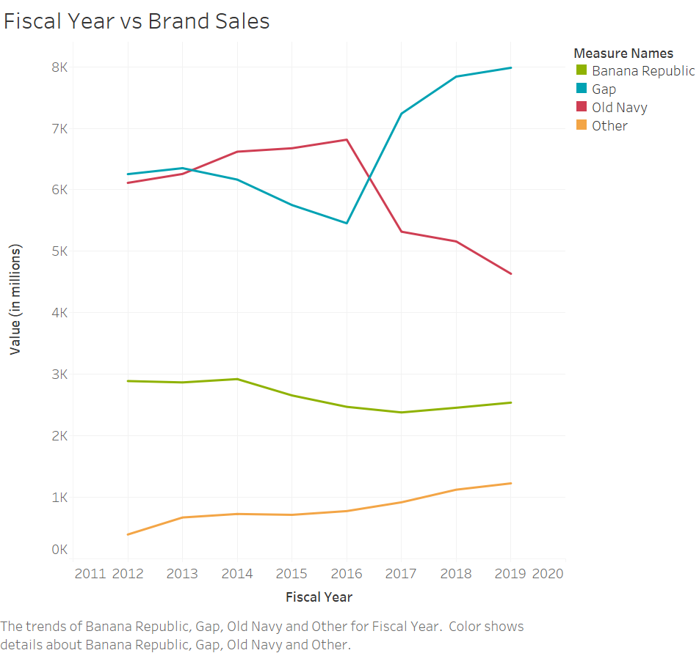
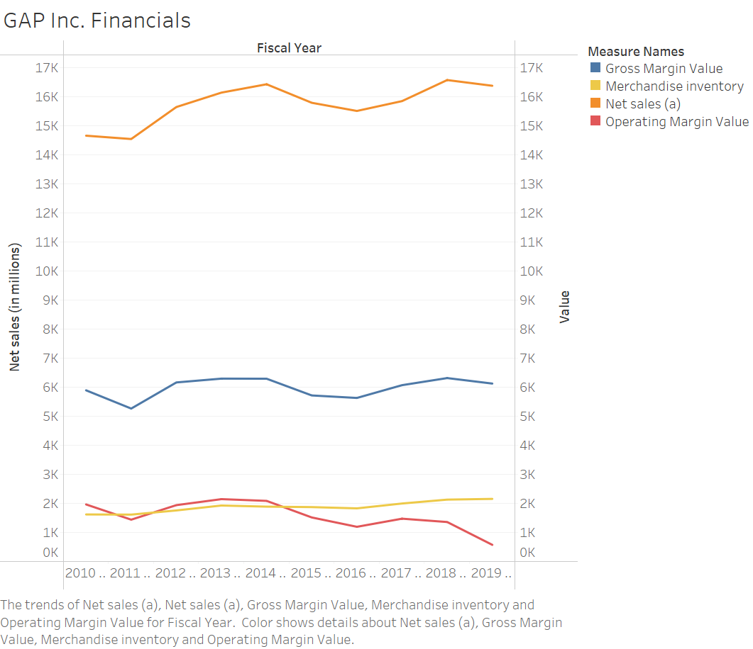
Financial Plots
Notes:
Samarth

Slide 13
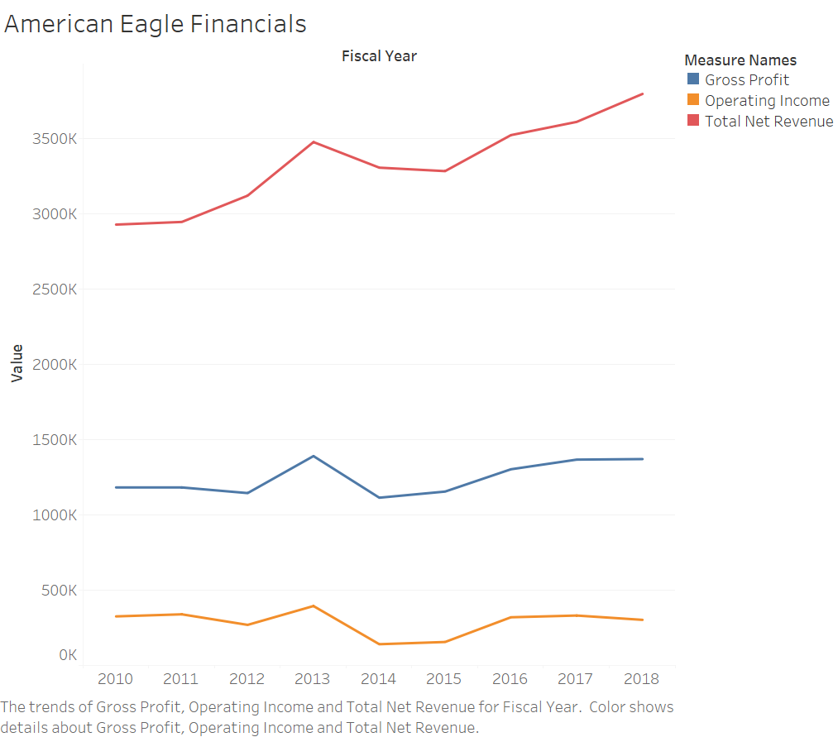
Financial Plots
Notes:
Samarth

Slide 14
Sentiment Analysis
Performed Sentiment Analysis on Customer Reviews for GAP, Banana Republic, Old Navy, American Eagle Outfitters.
Data Sources -
Trustpilot – an online platform that specializes in collecting and publishing customer reviews and ratings for businesses. https://www.trustpilot.com/review/gap.co.uk
https://www.trustpilot.com/review/www.oldnavy.com
https://www.trustpilot.com/review/bananarepublic.eu
https://www.trustpilot.com/review/americaneagleoutfitters.com
Notes:
Samarth

Slide 15
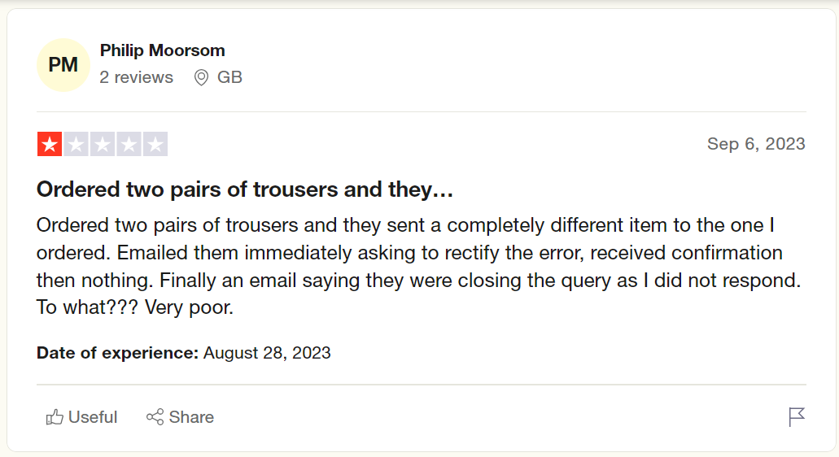
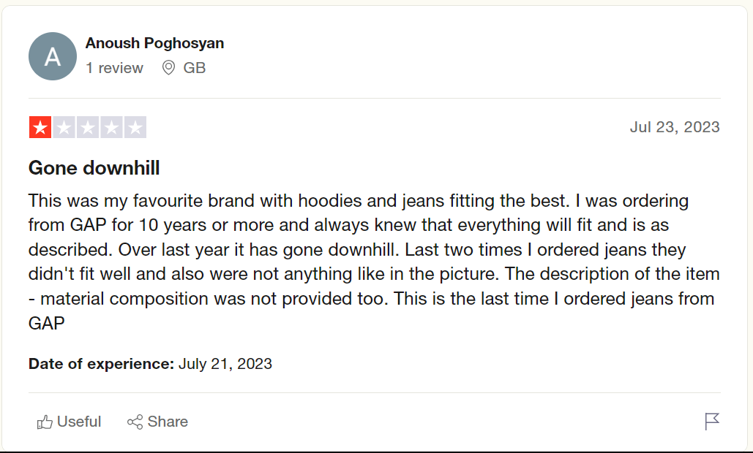
Reviews Scraped
Sentiment Classification: Azure Sentiment Analysis classifies text into different sentiment categories – positive, negative, neutral, mixed.
Notes:
Samarth

Slide 16
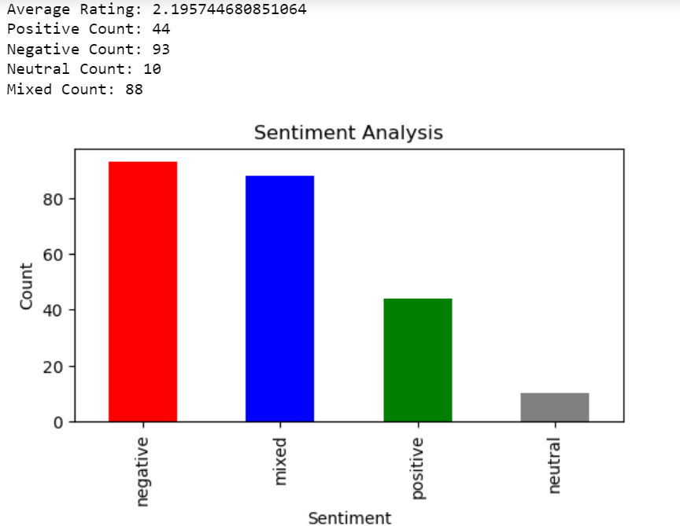
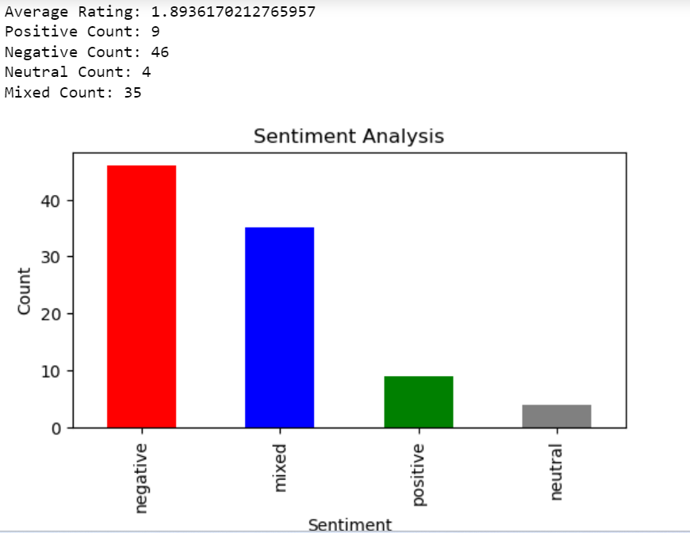
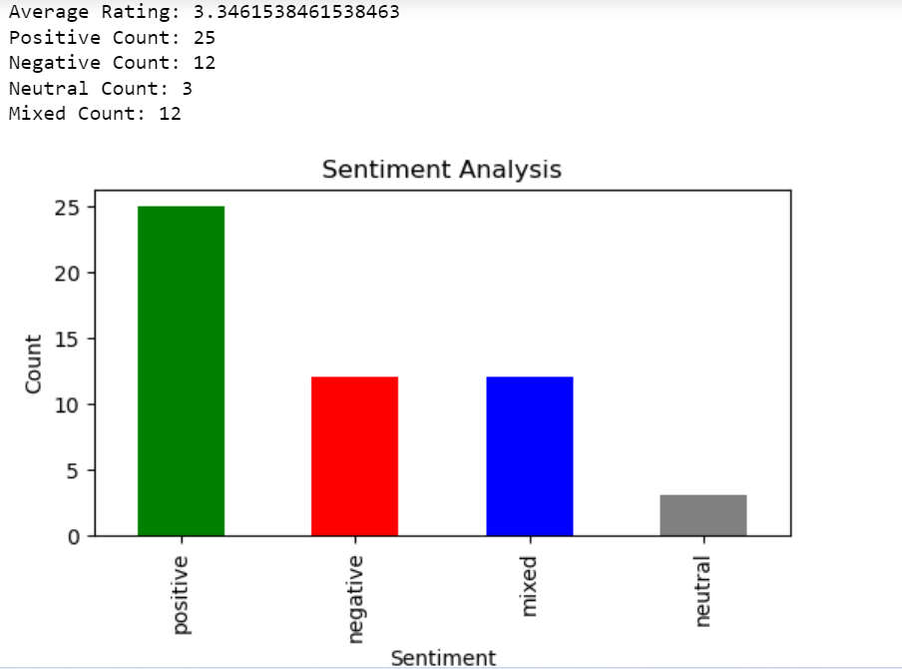
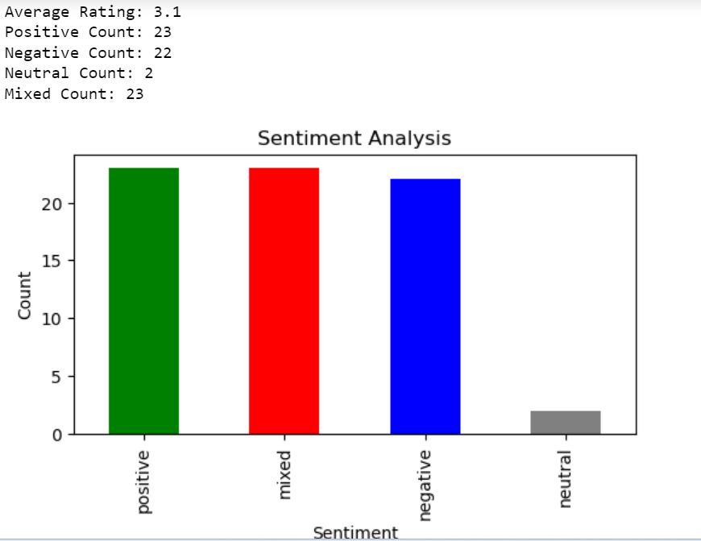
GAP
Banana Republic
Old Navy
American Eagle Outfitters
Notes:
Samarth

Slide 17
Recommendation
Continue to leverage data analytics for trend prediction and product development, as it can provide valuable insights into consumer preferences and market trends.
However, it's crucial to strike a balance between data-driven decision-making and creative vision. While data can inform product development, creative input remains essential for maintaining a unique brand identity and staying ahead in the fashion market.
Maintain a data-driven approach to inventory management by using real-time data to inform inventory decisions and predict shifting trends.
Consider reducing deep discounts and instead focus on offering products that resonate with customers. A "quality over quantity" approach can enhance brand perception.
Notes:
Samarth

Slide 18
Limitations
It's important to note that Gap Inc.'s financial performance is influenced by various factors, including consumer trends, competition, economic conditions, and strategic decisions.
The presence of inauthentic or deceptive reviews within the dataset can introduce a significant limitation to the sentiment analysis process.
The negative Google trend data could be affected by an unknown third event and might not be directly attributed to Peck's decision.
Notes:
Samarth

